Slide 1
Network Programming Lab

Slide 2
Answer from Last Lab
How to find the platform for python
import platform
platform.python_implementation()

Slide 3
Goals for the Lab
Setting and getting the default socket timeout.
How to handle the socket error gracefully.

Slide 4
Libraries to be used
Socket
Sys
Argparse.

Slide 5
Default socket timeout
Why do we need it?
Sometimes we need a specific amount of time for a defined service.
Banking, OTP, Anything in the realm of cryptography.
We will use the “import socket” to get the information about default timeout first then we will set one timeout and then display the result (set 200 as the timeout value).
Use help() for Socket library to find the get and set timeout functions.

Slide 6
Handle the socket error gracefully
We used try and except in the last class which took care of out errors but we have another way to handle the errors.
We use “socket.error”.
Why do we need a dedicated error handler for socket?

Slide 7
Contd.
When we make connections to send certain files we need
Host, port, and file.
We need certain steps to communicate properly i.e.
Create Socket.
Connect to host/port.
Sending Data.
Waiting to receive data.

Slide 8
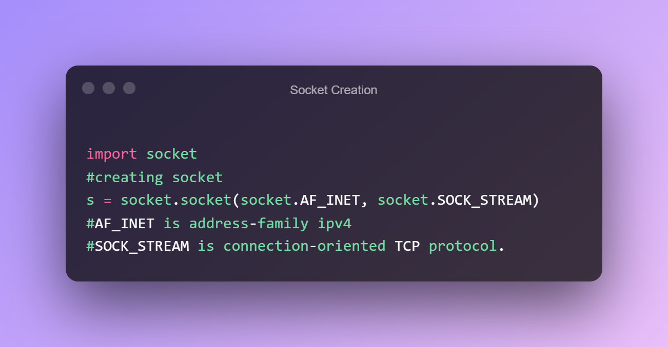
Contd.

Slide 9
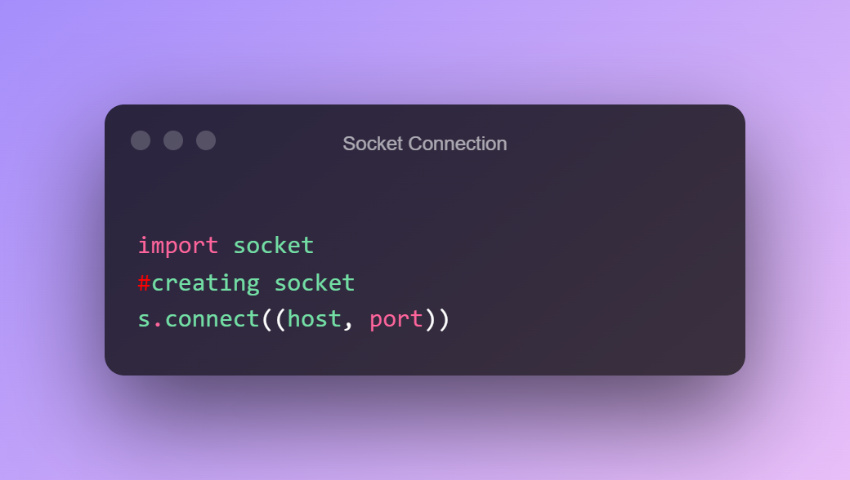
Contd.

Slide 10
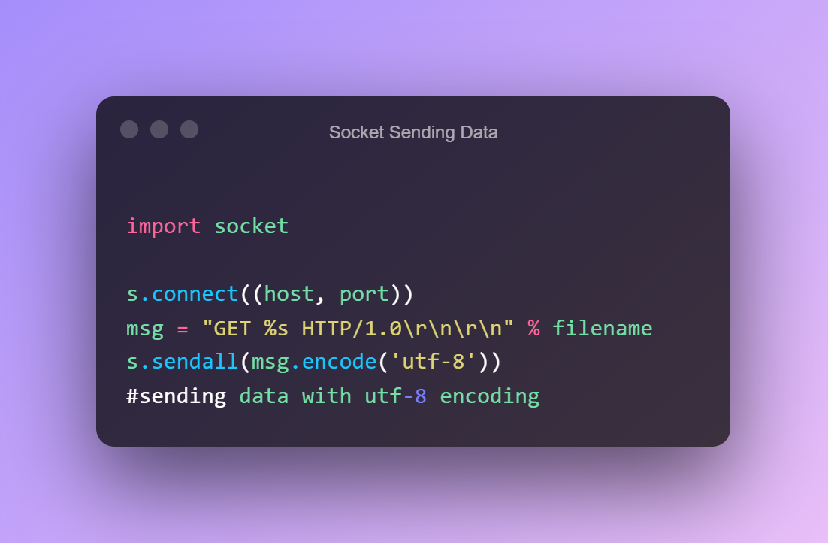
Contd.

Slide 11
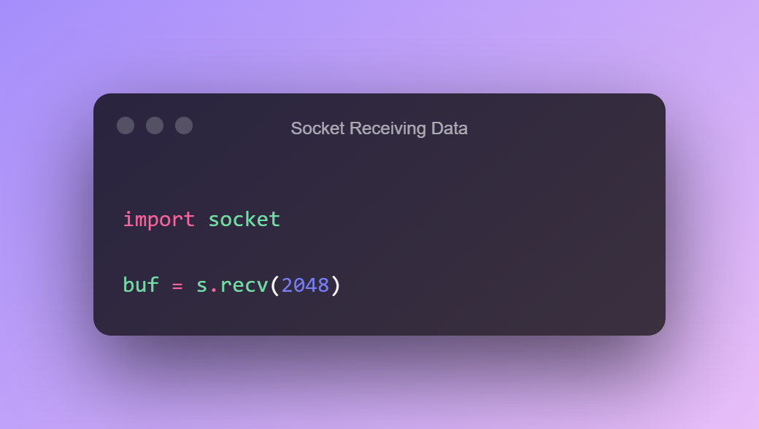
Contd.

Slide 12
Contd.
All 4 of them will have try and except blocks because we are handling socket errors.
We can hardcode the host, port, and filename or we can use the “argparse” library to get the input from the user.
Use sys library to exit. After every except block. Use help() function to find out more.

Slide 13
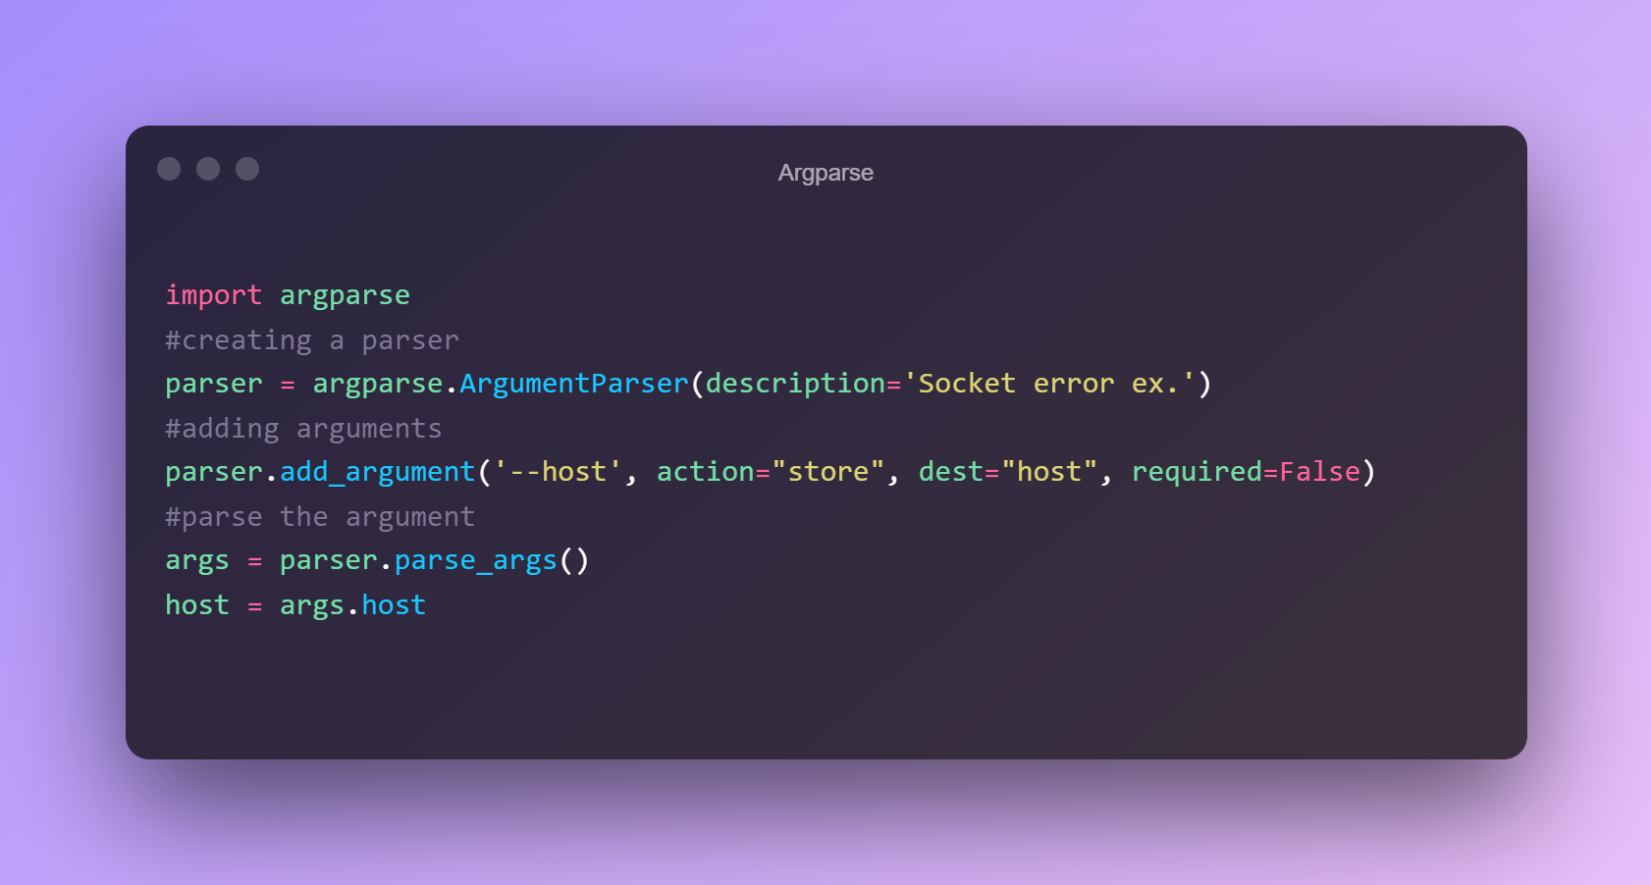
Argparse

Slide 14
Contd.
>>> python filename.py --host www.python.org
We have to make three such arguments for host, port, and filename.
WAP for Setting and getting the default socket timeout, the program should include how to handle the socket error gracefully?

Slide 15
Resources for lab.
https://towardsdatascience.com/a-simple-guide-to-command-line-arguments-with-argparse-6824c30ab1c3
https://zetcode.com/python/argparse/

